Slide 1



Emotion Recognition Using Convolutional Neural Network (CNN) Project
Team ID: 13

Slide 2
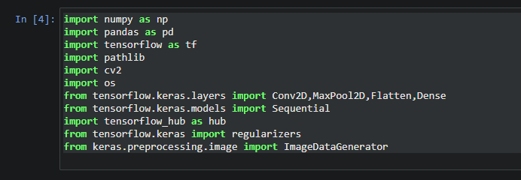
1 Importing the libraries

Slide 3
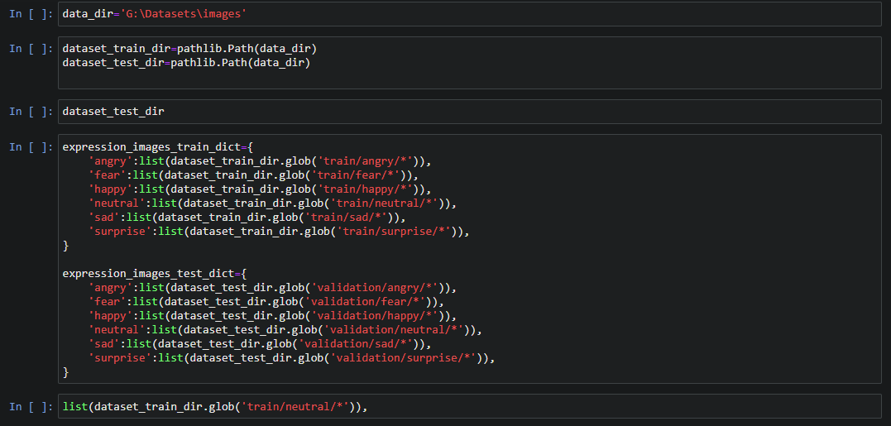
2 Importing The Face Expression Recognition Dataset

Slide 4
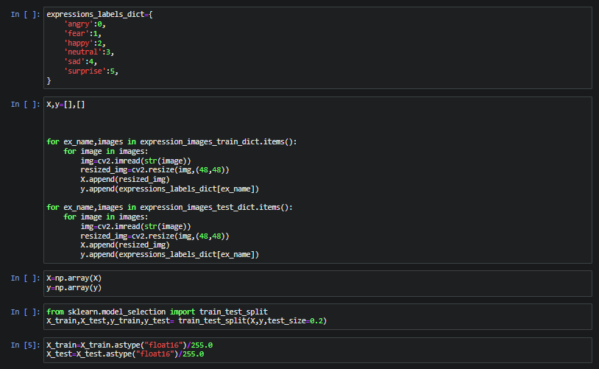
3 Classifying , Scaling, resizing the images & Splitting the dataset

Slide 5
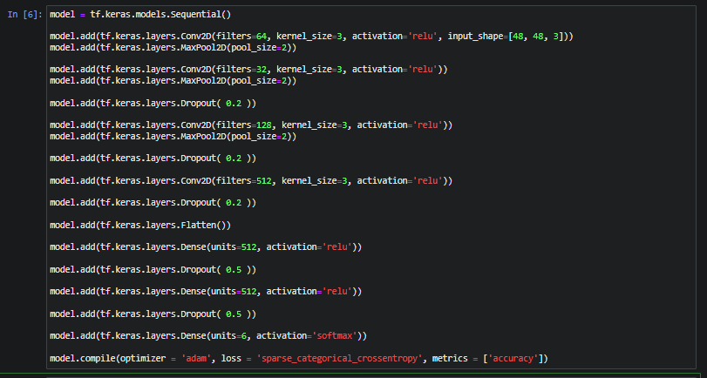
4 Model design

Slide 6
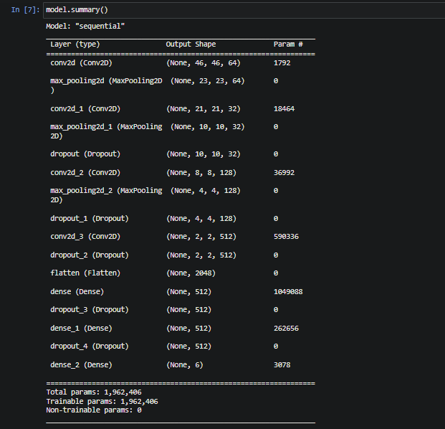
5 Model Summary

Slide 7
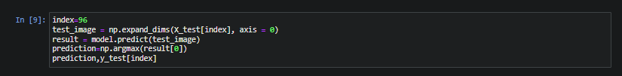
6 Model Testing

Slide 8
Model visualization Charts

Slide 9
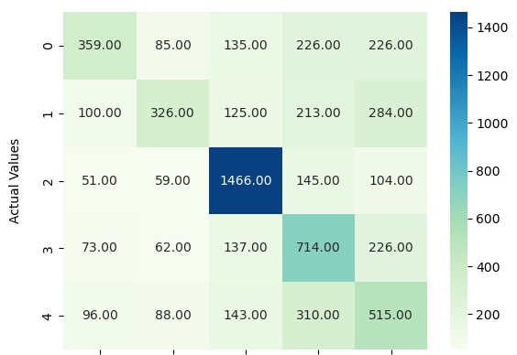
Confusion Matrix

Slide 10
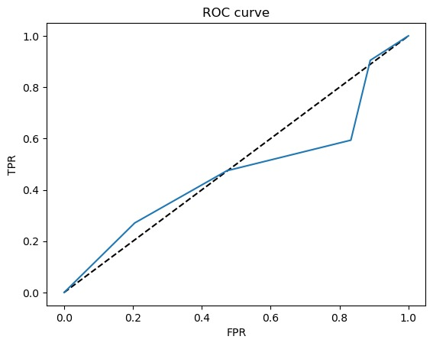
ROC Curve

Slide 11
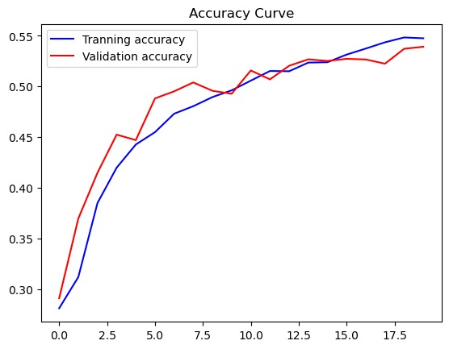
Accuracy Curve

Slide 12
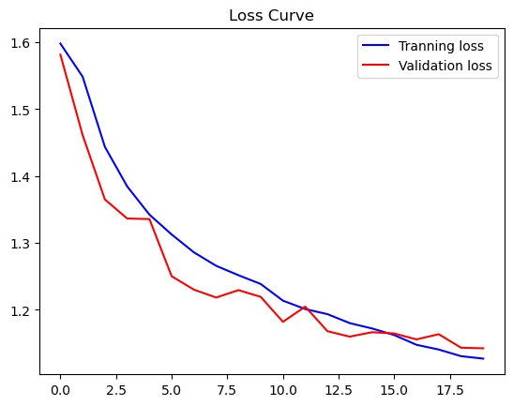
Loss Curve

Slide 13
Team 13 Members
Abdelragman Hamdy Abd-ElAaty | 202000510
Abdulla Shaaban Abdulrazeq | 202000548
Abdulrahman Yasser Sameer | 202000542
Ayat Ayman Hafez El-Shaal | 202000171
Shehab El-Din Mokhtaar El-Saeed | 202000441
Youssef Mostafa Abdulghany | 202001109

